Slide 1
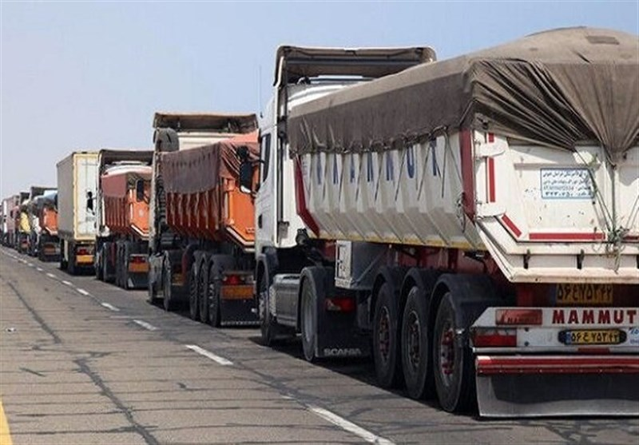
Direct Transport Connection App
“Connecting Transport Owners and Goods Managers Without Middlemen”
Team name : Innovators
Team members :
Vidusha L S (IT-1st year)
Harsha Vardhini S (CSE-1st year)
Anushya S (CSE-1st year)
Bhoomika T (CSE-1st year)

Slide 2
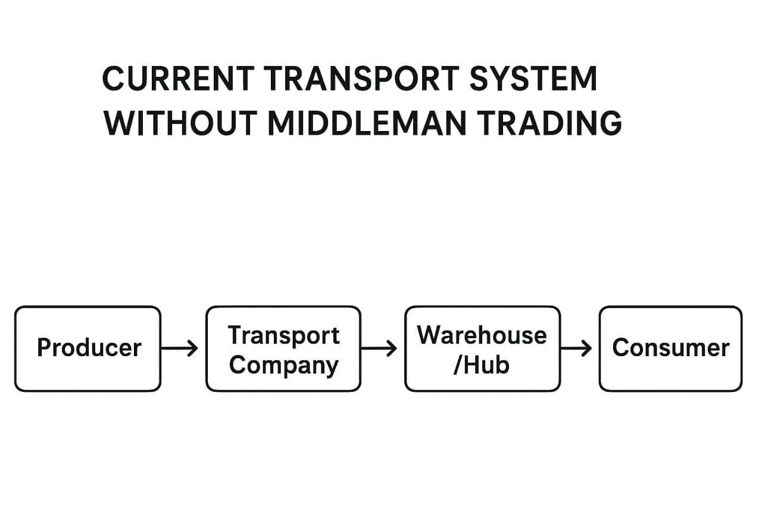
Introduction
Current Transport System
The present transport system typically involves multiple intermediaries , who coordinate between transport owners and goods managers.
This multilayered setup can lead to delays, lack of real-time information, increased costs, and difficulties in tracking goods.

Slide 3
How the Idea Works
Both goods managers and transport owners register and interact on a unified digital platform.
The app provides features for posting goods transport requirements and available transport resources in real time.
Automated matching algorithms pair suitable transport options with demand, enabling direct negotiation and deal finalization.
Integrated tracking and payment systems streamline shipment logistics from booking to delivery, all within the app.

Slide 4
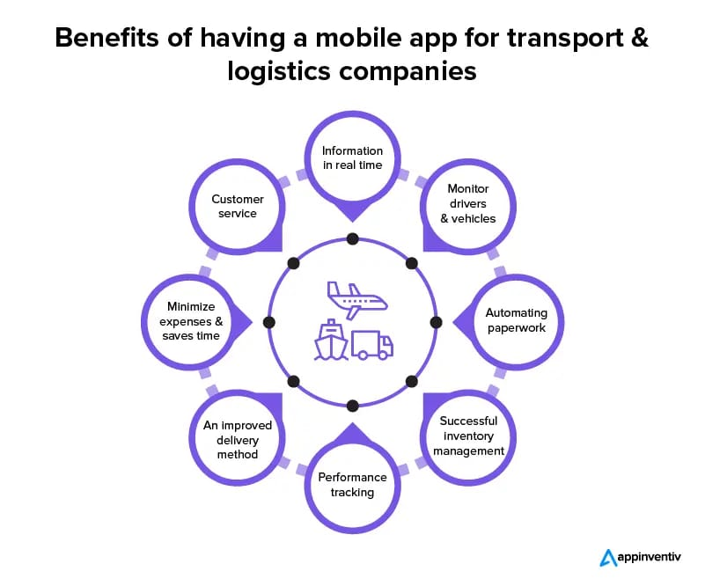
Key Benefits
Reduced Costs.
Faster Transactions.
Transparency and Trust.
Better Utilization.

Slide 5

Problem Statement
“In the current transport industry, goods delivery relies heavily on intermediaries who increase cost, delay communication, and reduce transparency. There is a need for a digital platform that enables direct connection between transport owners and goods managers.”
Highlight issues like:
Increased cost due to middlemen
Time delays
Communication gaps
Reduced profits for owners

Slide 6
Aim and objectives
Aim:
To develop an app that directly connects transport owners and goods managers to manage loads efficiently without intermediaries.
Objectives:
Eliminate third-party intermediaries
Improve transparency and communication
Reduce transportation cost and time
Enable real-time load booking and trackingIncrease profit margins for transport owners

Slide 7
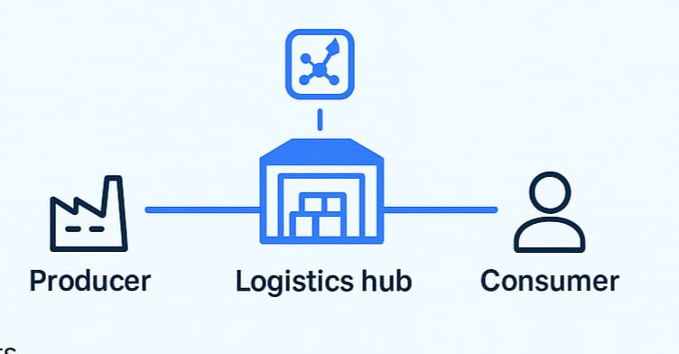
Proposed Solution
A mobile/web application that:
goods managers to post transport
requirements
transport owners view and accept loads
directly
Provides call options for direct
communication
Tracks transport progress in real
Time Includes secure payment gateway

Slide 8
System Architecture
GOODS MANAGER
POSTS LOAD
TRANSPORT OWNER
ACCEPTS LOAD
PAYMENT
DELIVERY CONFIRMATION
TRACKING

Slide 9
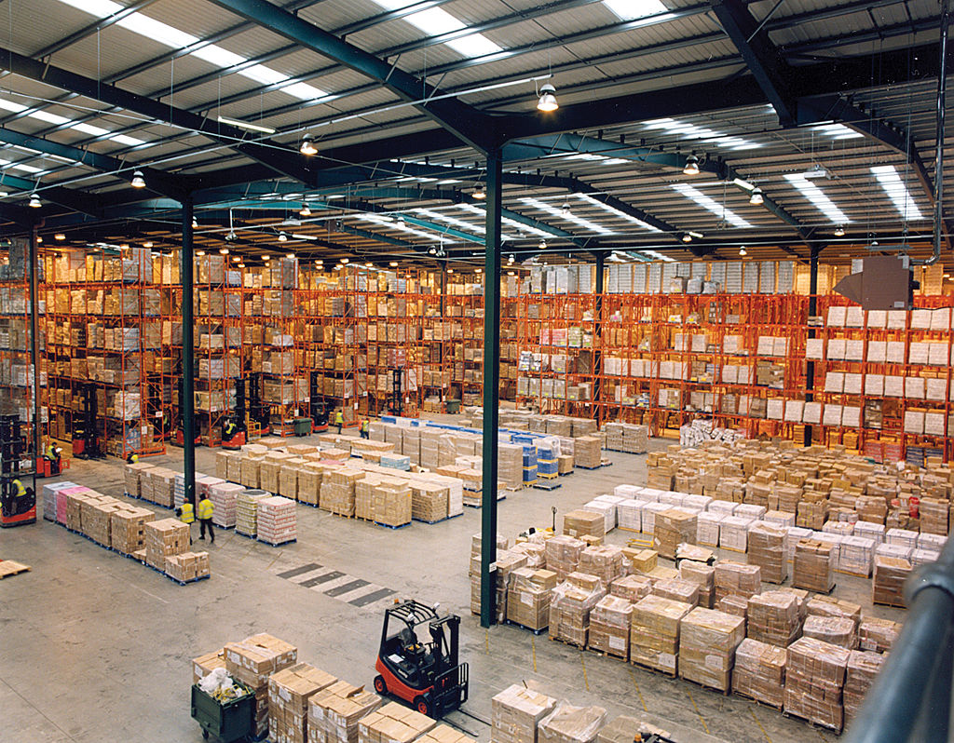
Market Scope / Use Case
Can be used by logistics companies, warehouse managers, small transport owners.
Expands across local and interstate transport.
High demand due to the rise of e-commerce deliveries.
This Photo by Unknown Author is licensed under CC BY

Slide 10
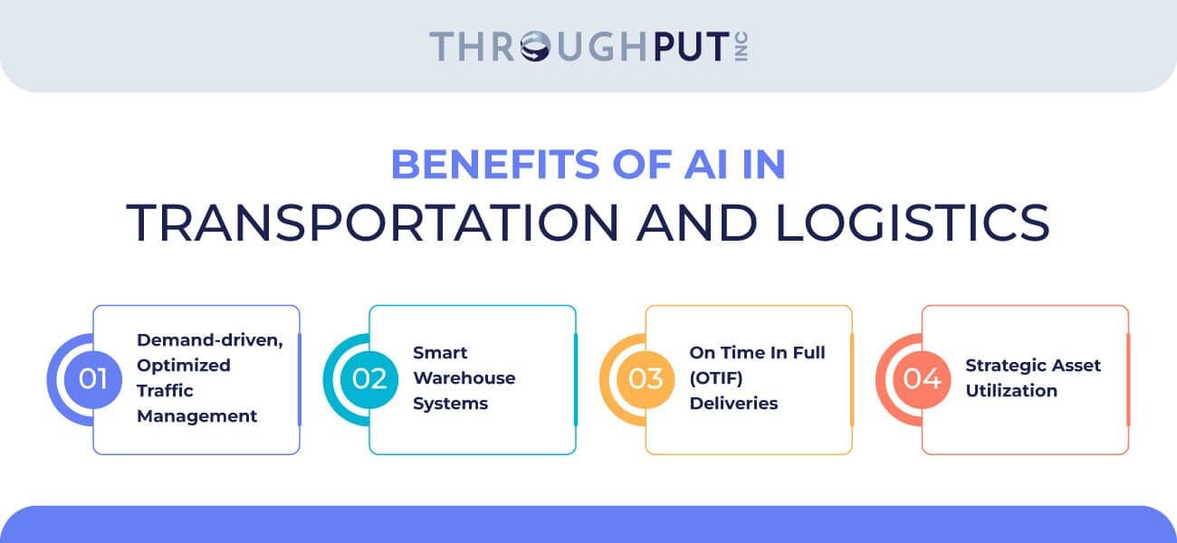

Future Enhancements
AI-based load suggestions
Smart route optimization
Fuel tracking system
Multilingual support for drivers

Slide 11
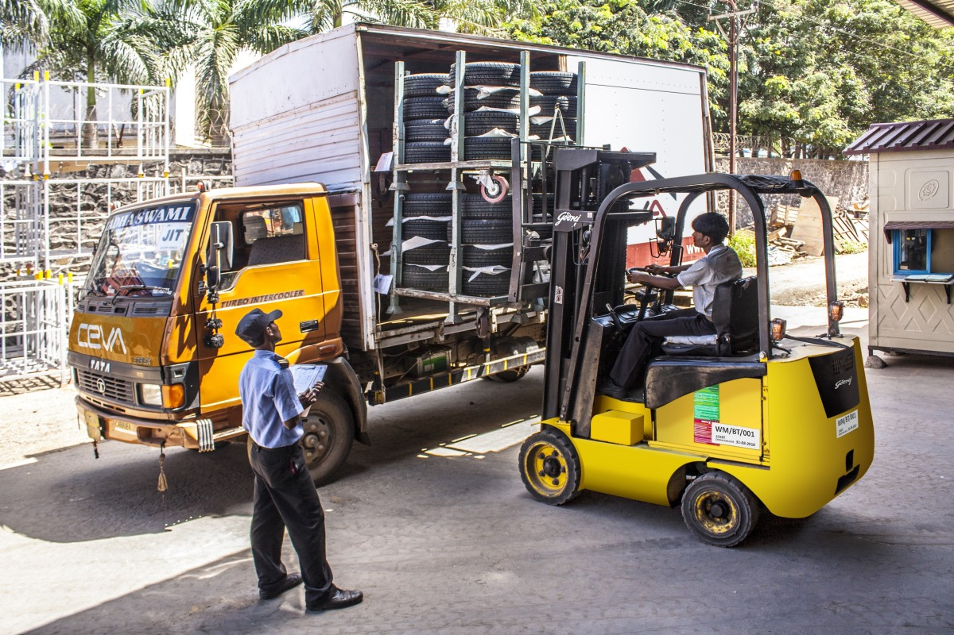
Conclusion:
Our app enhances efficiency by automating key processes, minimizing manual effort, and enabling real-time access to data for faster decision-making. It reduces costs through optimized resource utilization, paperless operations, and reduced human errors. Additionally, it builds transparency by providing clear data tracking, audit trails, and easy monitoring for all stakeholders—ensuring accountability and trust across every level of operation.

Slide 12
Thank you
❓ Questions & Answers
“We’d love to hear your thoughts and feedback!”

